Slide 1
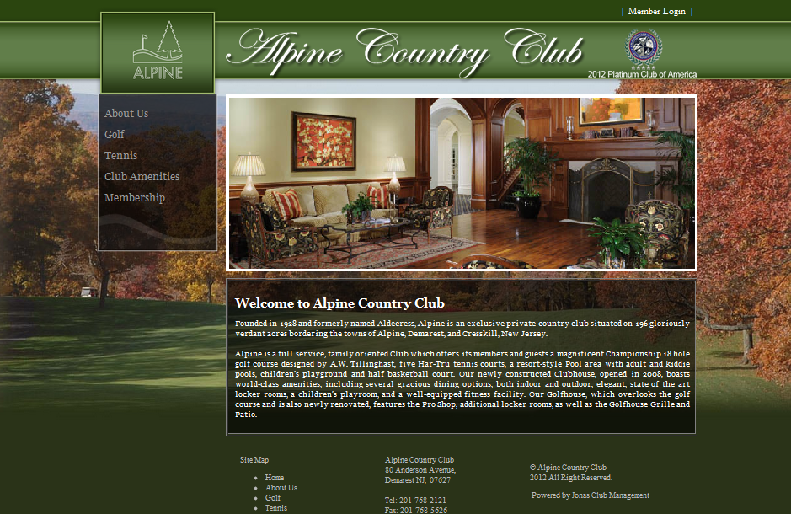
This is the original design idea—look and feel—classy, quiet, relaxing, very “men’s club”
Dona’s color scheme is black, gray and maroon (and cream if it looks okay, otherwise white)

Slide 2


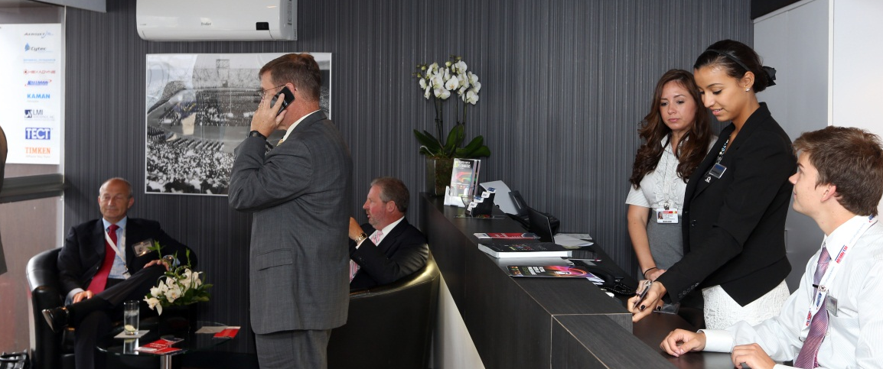
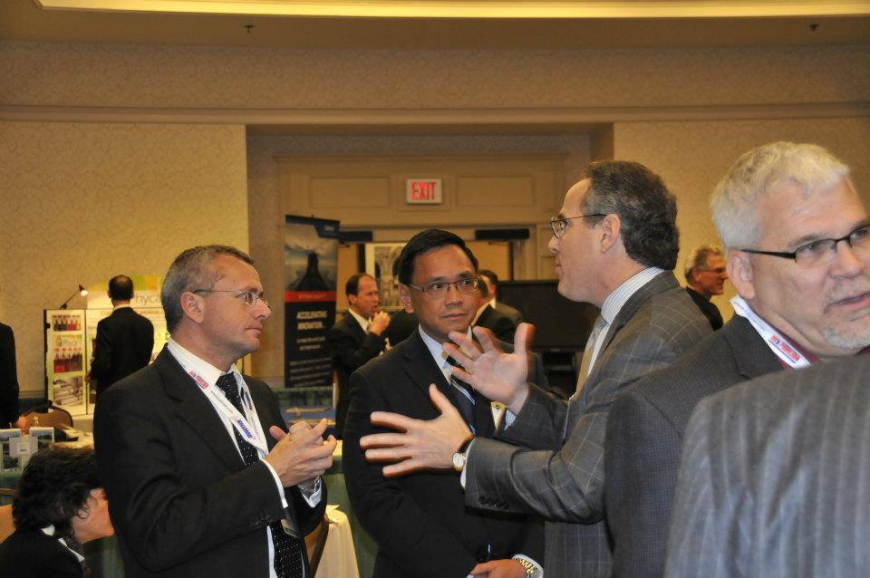



please use logo The Chalet the ultimate business setting
at selected international airshows
Amenities
Options
Client list
Testimonials
Photo gallery
See us in person
Contact us
BUSINESS CLASS The CHALET is located immediately along the flight line at major air shows around the world including the Paris Air Show, Farnborough, Dubai, Singapore and FIDAE. This exclusive business club setting provides you and your clients unobstructed views of the daily flight demonstrations in the show’s most elegant, upscale locale.
Open throughout the day for breakfast, lunch, afternoon tea, and other refreshments, and offering both inside and outside seating options, The CHALET provides the ideal backdrop for both formal and informal business discussions. Each structure is designed, constructed, outfitted and staffed by Kallman Worldwide, organizers of the U.S. Pavilion at the Paris Air Show since 1986.
Now, even smaller companies can be part of The Chalet
The Chalet Program is an affordable option for companies desiring an exclusive presence on the chalet line. The Chalet Program offers companies their own individual dining tables or conference rooms throughout the duration of the show, at a fraction of the cost of building, decorating, catering and staffing an entire facility.
video
virtual tour
The Chalet at

Slide 3
AMENITIES
Air conditioned/heated
Bar service with top shelf selections
Charging stations
Coat room
Coffee and tea available all day
Computer (Microsoft Office and Internet)
Concierge
Dedicated site manager
Formal buffet or plated gourmet meals Fresh flowers
Live digital news feeds
Private computer stations
Private restrooms
Receptionist
Secretarial services available
Soft seating conversation pits
Interpreters
Waiter/waitress service
Linen service
Wi-fi
Wine service

Slide 4
OPTIONS
The CHALET has all the amenities of a modern office.
The Kallman staff takes care of all the details, while you focus on your customers.
Private Conference Rooms:
The CHALET offers private conference rooms that allow you to conduct your important business in a discreet, quiet, and professional environment. We can arrange for the latest audio/visual and telecommunications equipment, as well as reliable, high-speed Internet to help you demonstrate your company's products and capabilities most effectively.
Reserved Dining Tables:
Fine dining and gracious hospitality leave an indelible impression in the minds of your clients. Once business has concluded, show your client the added hospitality of drinks or a gourmet meal. You and your guests will be treated to five-star dining as you view the airshow from your private balcony table.
Office Suites: The CHALET also offers multi-room office suites. This option can be built to your specifications inclusive of conference room, reception area, or work space based on your corporate requirements. The suite option is ideal for those with a demanding meeting schedule. Private Chalet Units: One chalet unit not enough? Two chalet units too much? Our clients experience the flexibility that isn't available when purchasing a chalet unit on your own. Don't let fixed size units keep you from obtaining the experience you desire. In The CHALET, you are able to purchase more than a unit or less than a unit. Dining rooms, conference spaces as well as exhibits can be incorporated into your layout depending on your specific space requirements and budget. The CHALET is also available to rent on public weekends for corporate hospitality events.

Slide 5
CLIENT LIST (VISITORS?)
SEE US IN PERSON
There is nothing like being there! We’d love to take you through one of our beautiful shared chalets. Arrange an appointment for a tour at any of our air shows (link to air show tab) by contacting Chalet Manager Dona McAvoy at +1 201-251-2600 x or donam@kallman.com.
CONTACT US
Dedicated chalets make the ultimate impression at the most important trade events of the year. Contact us for a complementary consultation and to see why companies like FLIR and Makino come back year after year.
The Chalet Program enables businesses with smaller budgets to “cast a disproportionate shadow “ to their customers.
Chalet Sales Manager:
Dona McAvoy
+1 201-251-2600 x
donam@kallman.com.
FOR EACH SHOW:
Floor plan of chalet
Floor plan of location at show
Past menus
Photos from past shows
Past clients
Past visitors

